Slide 1
Charing Cross Local Hospital update
30th April 2014

Slide 2
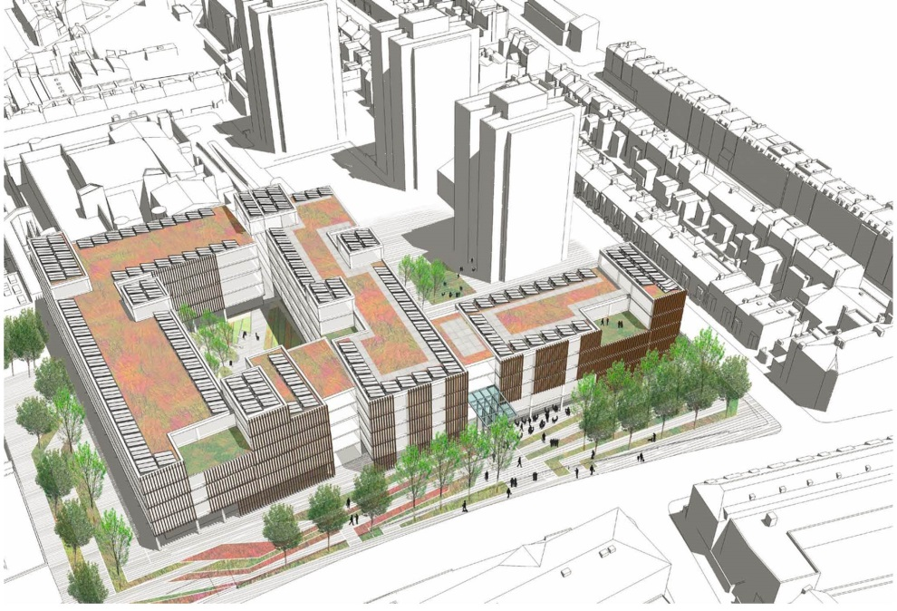
Agenda
Background
The new Charing Cross Local Hospital
Your views
Next steps
Current artists impression of the Local and Elective Hospital in Charing Cross

Slide 3
Background
Two significant transactions are occurring in parallel with Shaping a healthier future
Mount Vernon
RNOH
Hammersmith and Fulham Clinical Commissioning Group (HFCCG) decide priorities and buy health services for H&F residents
In 2011, HFCCG came together with seven other CCGs in North West London to createShaping a healthier future with a vision for delivering better care in North West London.
After major consultation in 2012, proposals included centralising services onto five major hospitals across North West London, with local hospitals developed at Ealing and Charing Cross, a specialist hospital at Hammersmith and an elective hospital at Central Middlesex
This decision was confirmed in October 2013 by the Secretary of State Jeremy Hunt after independent advice
Harefield
Northwick Park
Hillingdon
Central Middlesex
Hammersmith
Ealing
M
St Mary’s
Charing Cross
Royal
Royal Marsden
Brompton
West Middlesex
Chelsea and
Westminster
Specialist hospital
M
Local and Specialist hospital
with obstetric
-
led maternity unit and UCC
Local and Elective hospital with UCC
Integrated
Local and Major hospital with A&E and UCC
Local and Major hospital and
specialist eye hospital and
Hyper Acute Stroke Unit with A&E and UCC
Local hospital with A&E

Slide 4
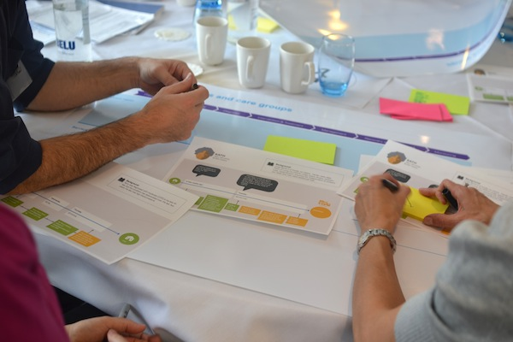
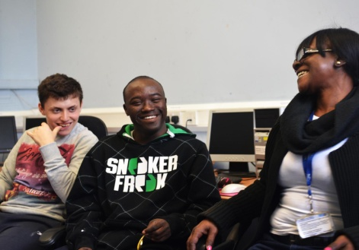
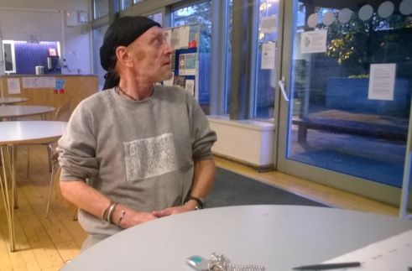
Examples of the engagement we have undertaken to develop the Local Hospital in H&F
Interactive Design Workshop 22/10/13
H&F Action on Disability
‘Drop in’ Dawes Road Hub
Broadway Homeless Centre
Headlines
Empower patients and carers to take control
Care centred around the patient
Multidisciplinary and multi skilled workforce
Headlines
Difficult transition from young people to adult services
Hard to communicate with clinicians
Need to empower young people to take control
Headlines
Enable community champions
Need to be better, more comfortable spaces
We need NHS system navigators
Headlines
Prejudice is a barrier to many homeless people
Lifestyle makes it harder to stick to regular appointments and medication

Slide 5
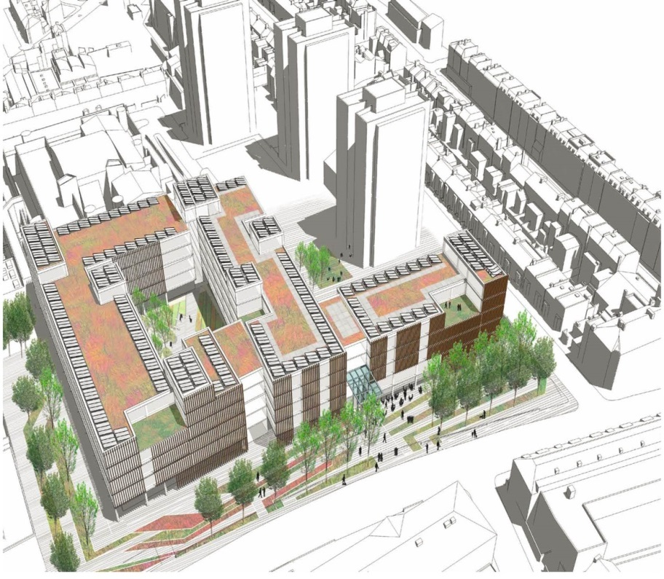
The new Charing Cross will see a 21st century healthcare facility for the local community
It will have a local Accident & Emergency unit, and an Urgent Care Centre, which will both be open 24/7 providing:
senior doctors and nurses and other emergency care professionals
access to specialist consultant opinion, social care and psychiatry
a wide range of day to day appointments including treatment
improved preventative approaches to health and wellbeing
It will not have Intensive Care Units which means that they will not accept ‘blue lights’

Slide 6
What we can anticipate to be provided in the new Charing Cross Hospital
Primary and Local Emergency Care
Care planning, outpatient appointments and access to specialist opinion
Beds for 24 hour care
Community Zone
The Hospital will have GPs on site, as well as
local Accident & Emergency unit, and an Urgent Care Centre which will both be open 24/7.
Who are these service for?
People who live and/or work close to the Hospital
Registered patients in the Borough
Services provided include:
Minor injuries and minor ailments
Fractures
Planned appointments with a GP
Urgent appointment with a GP
The hospital will provide two types of bedded care:
1) Active Prevention Care beds: for people requiring a short stay with access to diagnostics, monitoring, therapy services and specialist opinion.
2)Active Re-ablement Care for people requiring rehabilitation, delivered by a team including GPs with access to diagnostics, therapies and specialist Consultant opinion
The Community Zone will include services and activities that support all families and communities to build their social networks, increase wellbeing and manage their own conditions better.
Services provided include:
Volunteer coordination service
Self-service technologies
Patient buddying service
Space for people to meet, discuss and learn about their conditions
Expert patient programme
Health and care services to enable patients to make informed decisions about their health and care needs.
Services provided include:
Diagnostic investigations
Clinical expertise to diagnose conditions and set high quality treatment plans
Follow-up appointments after surgery, or other treatment
Ongoing support for those with long term care needs, co-ordinating health and social care services.

Slide 7
YOUR Views –tell us your experience of using a local hospital
1) What currently works well in your local hospital? [Please use the box below]
2) Thinking about the service you currently receive, how can this be improved in the new local hospital? [Please use the box below]

Slide 8
What happens between now and 2018?
Later this year, outline plans for Charing Cross will be developed and put through additional checks by key patient representatives such as Jane Wilmot.
2014/5: Further engagement events will help to finalise the local hospital plans
2016/17 construction and building work on site including the potential demolition of the tower
2018: New local hospital is expected to open
Any questions?

